Slide 1
FEA based resolver optimization -10102019
ΦDArc1
RArc1
RArc2
ΦDArc2
m in
m th
m width
b th
ΦDin

Slide 2
FEA based resolver optimization -10102019
Objective1 = THD weight1 = 100
Objective2 = Magnet volume weight2 = 10^9
12 population, 50 iteration
Cost = THD* 100 + Magnet volume*10^9
Optimized design

Slide 3
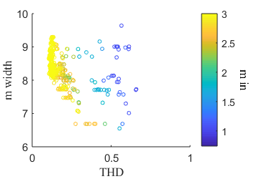
FEA based resolver optimization -10102019
PM Hc = 900000
Magnet volume and THD has no distinctive correlation
D arc 2 tend to be close to D arc 1 for THD
THD reduced with increasing m in
THD reduced with long magnet width
No correlation between magnet thickness and THD
THD reduced with small deg arc 1
THD and deg arc 2 does is not related

Slide 4
FEA based resolver optimization -10112019
PM Hc = 900000
Magnet volume and THD has no distinctive correlation
D arc 2 tend to be close to D arc 1 for THD
THD reduced with increasing m in
THD reduced with long magnet width
No correlation between magnet thickness and THD
THD reduced with small deg arc 1
THD and deg arc 2 does is not related

